Slide 1
CodiNeo
A Documentation Generation System Using
Hash-Based Virtual Structural Copy Algorithm for Design Pattern Learning in DEVCON Luzon
Researchers: Balbarosa, J. A. | De Leon, M. Z. | Santander, J. J.
Institution: FEU Institute of Technology — Bachelor of Science in Computer Science
Defense: Thesis 3 Defense
Date: 2026
CodiNeo — A Documentation Generation System for Design Pattern Learning
1

Slide 2
Statement of the Problem
Chapter 1 — Section 1.3
● General problem: Novice C++ developers in collaborative, learning-oriented environments such as DEVCON Luzon struggle to recognise software design patterns inside real source code, and existing tools either skip the structural evidence or emit ungrounded LLM narration.
● Specific problem 1: Static-analysis tools surface raw findings without binding them to the design-pattern concept the learner is studying.
● Specific problem 2: AI-driven coding assistants generate fluent prose that is not anchored to the actual structure of the submitted code, leading to documentation drift.
● Specific problem 3: Existing pattern-detection research is not packaged as a teachable workflow that a student can submit code to and immediately read back evidence-bound explanations.
● Specific problem 4: There is no reproducible, evaluation-ready C++ detector that exposes its verdicts, evidence, complexity, and confusion-matrix metrics for academic study within the Philippine collegiate context.
CodiNeo — A Documentation Generation System for Design Pattern Learning
2

Slide 3
Objectives of the Study
Chapter 1 — Section 1.4
● General: To design, implement, and evaluate CodiNeo as a documentation-generation system that uses a Hash-Based Virtual Structural Copy algorithm to support design-pattern learning for novice C++ developers in DEVCON Luzon.
● Specific 1: Construct a deterministic C++ microservice that performs lexical scan, virtual structural-copy construction, pattern dispatch, evidence binding, and hash-and-link analysis.
● Specific 2: Pair every detected verdict with a documentation-oriented explanation and a pre-templated unit-test scaffold drawn from the pattern catalog.
● Specific 3: Provide a learner-to-developer pathway through which DEVCON Luzon interns can study a pattern module and then exercise the studio against their own C++ artefacts.
● Specific 4: Evaluate CodiNeo against the ISO/IEC 25010 quality model, against KPI-based technical metrics, and against confusion-matrix accuracy for the supported pattern catalog.
● Specific 5: Verify the algorithm's time- and space-complexity claims independently through an algorithm evaluator and a research statistician.
CodiNeo — A Documentation Generation System for Design Pattern Learning
3

Slide 4
Scope and Limitations
Chapter 1 — Section 1.7
In scope
Out of scope
● Class-level C++ analysis. Complete class and struct declarations.
● Supported pattern catalog. Only patterns shipped with the prototype.
● Two pathways. Learner modules + Developer Studio.
● DEVCON Luzon cohort. Internship-context evaluation.
● Documentation outputs. Anchored to bound structural evidence.
● Templated unit tests. GoogleTest scaffolds per pattern.
● Function- or file-only analysis. without class context.
● Patterns outside the catalog. no claim of generality.
● Runtime tracing. verdict is structural, not behavioural.
● Cross-service integration. for user-submitted code.
● End-to-end user-flow testing. for a class snippet.
● Languages other than C++. Java/Python/C# left for future work.
CodiNeo — A Documentation Generation System for Design Pattern Learning
4

Slide 5
Conceptual Framework
Chapter 1 — Section 1.6
INPUT
PROCESS
OUTPUT
• Pasted C++ snippet, file, or multi-file upload
• Pattern catalog (token + structural ladder)
• DEVCON Luzon intern profile
• Expert evaluator profile
• Lexical scan & tokenisation
• Virtual structural-copy construction
• Pattern dispatch (specificity ladder)
• Evidence binding & content hash
• Documentation + test-scaffold synthesis
• AI explanation grounded on verdicts
• Detected pattern verdicts
• Bound code-evidence with highlights
• Beginner-friendly documentation
• Pre-templated unit tests
• KPI + confusion-matrix metrics
• Saved analysis runs for research
CodiNeo — A Documentation Generation System for Design Pattern Learning
5

Slide 6
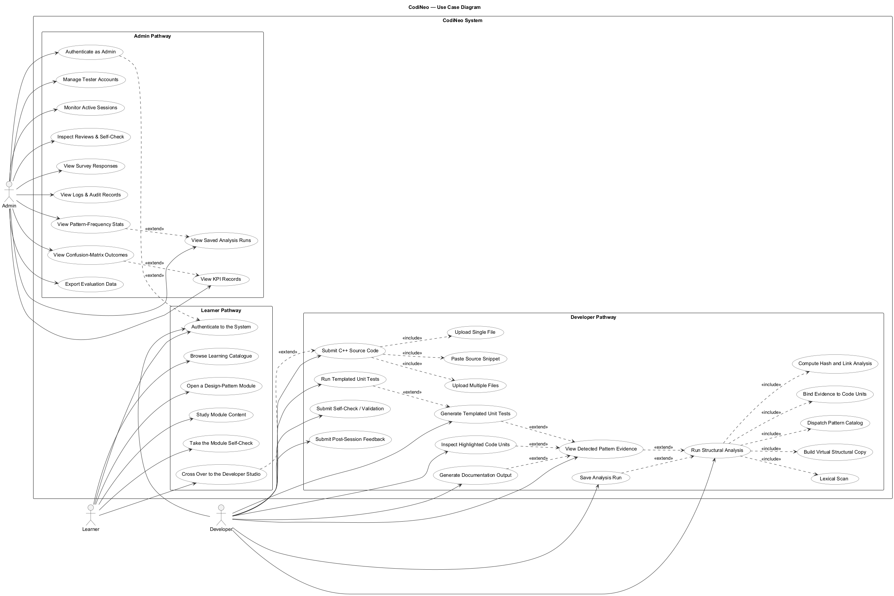
Methodology — Use Case Diagram
Chapter 3 — Section 3.4.4
Figure 5. CodiNeo Use Case Diagram (Learner, Developer, Admin actors with include/extend relations)
CodiNeo — A Documentation Generation System for Design Pattern Learning
6

Slide 7
Methodology — Activity Diagram
Chapter 3 — Section 3.4.3
[ Insert Activity Diagram here ]
● Login & route. Learner / Developer / Admin enter their pathway.
● Learner side. Browse modules → study → cross-over to Studio.
● Developer side. Submit C++ → validate → analyse → bind evidence → render.
● Save & feedback. Persist run, surveys, KPI.
● Admin side. Monitor runs, KPI, confusion matrix, exports.
CodiNeo — A Documentation Generation System for Design Pattern Learning
7

Slide 8
Methodology — Class Diagram
Chapter 3 — Section 3.4.5
[ Insert Class Diagram here ]
● User / TesterAccount. Login, role, session.
● LearningModule. Pattern lessons & self-check.
● AnalysisRun. Submission, hash, verdicts.
● PatternEvidence. Bound to code units & lines.
● DocumentationOutput. Grounded on PatternEvidence.
● TestScaffold. GoogleTest template instance.
● KPIRecord / ConfusionEntry. Research-grade metrics.
CodiNeo — A Documentation Generation System for Design Pattern Learning
8

Slide 9
Algorithm — Hash-Based Virtual Structural Copy Pipeline
Chapter 3 — Section 3.4
1. Source-code submission
2. Input validation (backend)
3. Lexical scanning (microservice)
4. Virtual structural-copy construction
5. Pattern dispatch (specificity ladder)
6. Evidence binding to code units
7. Hash & link analysis (content-addressed)
8. Documentation + test-target preparation
9. Structured JSON report generation
10. Frontend presentation (cards + evidence + tests)
Deterministic detector — verdicts are reproducible. AI explanation is grounded on bound evidence and cannot override the detector.
CodiNeo — A Documentation Generation System for Design Pattern Learning
9

Slide 10
Algorithm — Time & Space Complexity
Chapter 3 — Sections 3.4.1 / 3.4.2
Time complexity
Space complexity
● Lexical scan: O(N)
● Structural copy: O(N)
● Pattern dispatch: O(N · P) → O(N) since P is fixed
● Hash & link: O(N) average
● Report generation: O(N) bounded by evidence
● Overall: O(N) under prototype scope
● Token storage: O(N)
● Structural copy: O(N)
● Hash / link table: O(K) ⊆ O(N)
● Evidence + docs: O(E + D) ⊆ O(N)
● Overall: O(N) under prototype scope
● Verification: Algorithm evaluator + research statistician (3.8)
CodiNeo — A Documentation Generation System for Design Pattern Learning
10

Slide 11
Respondent Profile
Chapter 4 — Section 4.2
Intern Cohort (n = ___)
Professional Cohort (n = ___)
Year Level | Frequency | Percentage
First year | __ | __%
Second year | __ | __%
Third year | __ | __%
Fourth year | __ | __%
Others | __ | __%
Total | __ | 100%
Years of Experience | Frequency | Percentage
5–7 years | __ | __%
8–10 years | __ | __%
11 years and above | __ | __%
Total | __ | 100%
Table 10–12. Respondent profile by year level and years of experience. Values pending consolidated export.
CodiNeo — A Documentation Generation System for Design Pattern Learning
11

Slide 12
Functional Suitability
Chapter 4 — Section 4.3.1
Indicator | Intern Cohort | Professional Cohort | Combined Mean | Interpretation
Accuracy of code analysis | ___ | ___ | ___ | ___
Relevance of documentation outputs | ___ | ___ | ___ | ___
Alignment of evidence with verdicts | ___ | ___ | ___ | ___
Usefulness of unit-test targets | ___ | ___ | ___ | ___
Weighted Mean | ___ | ___ | ___ | ___
Table 14. Functional Suitability of CodiNeo. Likert 1–5. Verbal interpretation per Section 3.8.3.
Interpretation. Both cohorts assessed the system as performing its intended functions within the supported pattern catalog. Mean values, verbal interpretations, and per-question deviations will be populated from the consolidated questionnaire export.
CodiNeo — A Documentation Generation System for Design Pattern Learning
12

Slide 13
Usability & Performance Efficiency
Chapter 4 — Sections 4.3.2 / 4.3.3
Usability
Performance Efficiency
Indicator | Mean | Interpretation
Ease of understanding outputs | ___ | ___
Clarity of documentation | ___ | ___
Learning-support effectiveness | ___ | ___
Weighted Mean | ___ | ___
Metric | Value | Interpretation
Average processing time (ms) | ___ | ___
Memory usage (MB) | ___ | ___
Throughput (runs / min) | ___ | ___
Weighted Mean | ___ | ___
Tables 15–16. Likert means for usability; KPI measurements for performance. Values pending.
Interpretation. Usability is reported from intern-cohort responses; performance metrics are pulled directly from the system's KPI store during alpha-test runs. The two are reported as independent silos and are not combined.
CodiNeo — A Documentation Generation System for Design Pattern Learning
13

Slide 14
Reliability & Maintainability
Chapter 4 — Sections 4.3.4 / 4.3.5
Reliability
Maintainability
Metric | Mean | Interpretation
Consistency of results | ___ | ___
Error handling | ___ | ___
Weighted Mean | ___ | ___
Metric | Mean | Interpretation
Ease of extending system | ___ | ___
Code modularity | ___ | ___
Weighted Mean | ___ | ___
Tables 17–18. Reliability and Maintainability indicators (expert cohort). Values pending.
Interpretation. Reliability is interpreted strictly against result-consistency and error-handling behaviour during the evaluation period. Maintainability is interpreted against the layered microservices architecture documented in Section 3.4.6. Each is read on its own.
CodiNeo — A Documentation Generation System for Design Pattern Learning
14

Slide 15
Code Understanding & Documentation Outputs
Chapter 4 — Sections 4.4 / 4.5
System Effectiveness in Code Understanding
Effectiveness of Documentation-Oriented Outputs
Indicator | Mean | Interpretation
Understanding of code structure | ___ | ___
Identification of key components | ___ | ___
Comprehension of program logic | ___ | ___
Weighted Mean | ___ | ___
Indicator | Mean | Interpretation
Clarity of generated documentation | ___ | ___
Usefulness for learning | ___ | ___
Alignment with code structure | ___ | ___
Weighted Mean | ___ | ___
Tables 19–20. Code-understanding and documentation indicators. Values pending.
CodiNeo — A Documentation Generation System for Design Pattern Learning
15

Slide 16
Pattern Detection & KPI Metrics
Chapter 4 — Sections 4.6 / 4.7
Effectiveness of Design Pattern Detection
Quantitative KPI Metrics (Confusion Matrix)
Indicator | Mean | Interpretation
Accuracy of pattern identification | ___ | ___
Helpfulness in learning patterns | ___ | ___
Weighted Mean | ___ | ___
Metric | Value
Accuracy | ___
Precision | ___
Recall | ___
F1 Score | ___
Tables 21–22. Pattern-detection perception (Likert) and technical KPI (confusion-matrix derived). Values pending.
Interpretation. The perception metrics (left) describe how respondents experienced the detector. The technical KPIs (right) describe the detector itself, computed against the labelled ground-truth set held constant for every analysis run. The two are read independently.
CodiNeo — A Documentation Generation System for Design Pattern Learning
16

Slide 17
Reliability of the Survey & Summary of Findings
Chapter 4 — Section 4.8 / Chapter 5 — Section 5.2
Cronbach's Alpha (Survey Reliability)
Summary of Findings (ISO/IEC 25010)
Subscale | α
Functional Suitability | ___
Usability | ___
Performance Efficiency | ___
Reliability | ___
Maintainability | ___
Whole survey | ___
Category | Weighted Mean | Response
Functional Suitability | ___ | ___
Usability | ___ | ___
Performance Efficiency | ___ | ___
Reliability | ___ | ___
Maintainability | ___ | ___
Total Average | ___ | ___
Tables 23–24. Cronbach's α per subscale (target ≥ 0.70) and ISO/IEC 25010 summary. Values pending.
CodiNeo — A Documentation Generation System for Design Pattern Learning
17

Slide 18
Conclusions
Chapter 5 — Summary of Findings and Conclusions
● 1. CodiNeo provides a functionally suitable platform for deterministic detection of supported design-pattern evidence in submitted C++ source code, with documentation anchored to that evidence.
● 2. The Hash-Based Virtual Structural Copy algorithm operates within linear time and linear space bounds, jointly supported by the algorithm evaluator's signed verification and the statistician's regression.
● 3. Documentation-oriented outputs produced by the AI explanation layer, grounded on deterministic verdicts, are perceived as usefully aligned with the structural evidence they describe.
● 4. The learner-to-developer pathway allows conceptual exposure to a pattern module to be followed by structural analysis of the learner's own C++ artefacts within the DEVCON Luzon context.
● 5. The layered microservices architecture and the modular pattern catalog allow CodiNeo to be extended with additional design patterns without re-architecting the analyser.
CodiNeo — A Documentation Generation System for Design Pattern Learning
18

Slide 19
Recommendations
Chapter 6 — Recommendations
● Future researchers. Expand the pattern catalog beyond the prototype set; repeat the empirical complexity study; port the algorithm to Java, Python, and C# to test generality.
● Instructors & DEVCON Luzon. Integrate the learner pathway into the internship curriculum as a pre-requisite for the design-pattern unit.
● Learners. Submit one class or struct at a time when first learning a pattern so the analyser's verdict and bound evidence remain legible.
● Maintainers & contributors. Keep the catalog as a specificity ladder; keep hashing over the virtual structural copy; keep the deterministic detector authoritative over the AI layer.
● Adopting institutions. Run an independent algorithm-verification cycle (evaluator review + statistician regression) before using CodiNeo as a grading input.
CodiNeo — A Documentation Generation System for Design Pattern Learning
19

Slide 20
Thank you
Questions?

